Slide 1
Clickstream And Qualitative Analysis

Slide 2
Visitor Acquisition Strengths
Click Density Analysis
Measuring Visits to Purchase
Sources of Traffic
Visitor Analysis
Traffic analysis
Internal Site Search Analysis
Pay Per Click/Paid Search Analysis
Direct Traffic Analysis
Email Campaign Analysis
Rich Experience Analysis(Flash, Video, and Widgets)

Slide 3
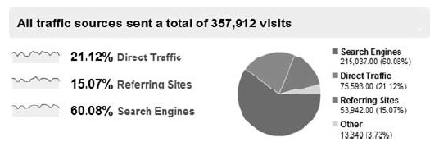
Visitor Acquisition Strengths

Slide 4
Click Density Analysis
The In-Page Analytics report shows the number of clicks on each link on a page. It also shows other helpful information such as Revenue from clicks on a link, Goal Conversions, and so on.
The In-Page Analytics report shows % Page Views, Time on Page, Time to the Page, % Exits, and Keywords that brought people to the page.

Slide 5
Visitor behavior analysis
Visitor behavior analysis is a method of conducting qualitative research on visitors’ website behavior.
Visitor behavior analysis involves employing multiple qualitative tools that help you track your website’s performance

Slide 6
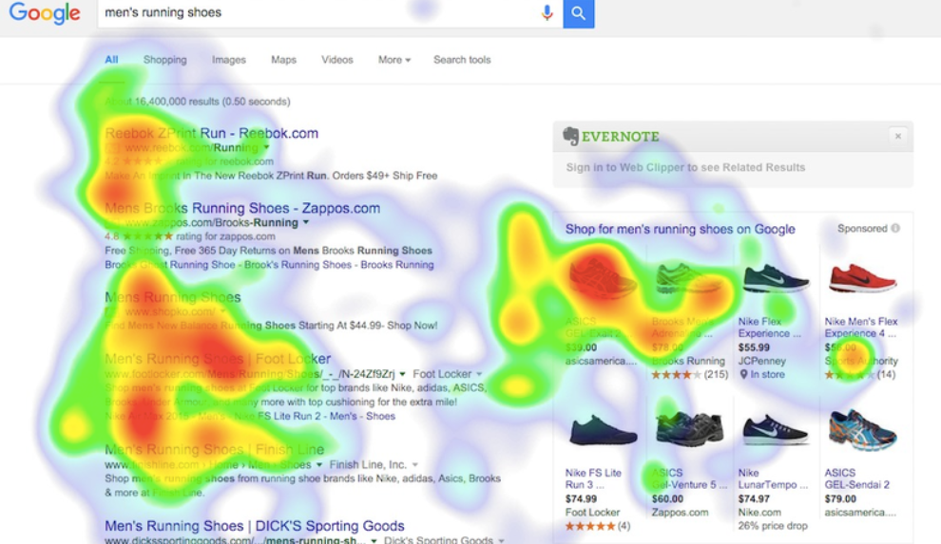
Website heatmaps
Website heatmap tracks visitors’ on-site behavior like scrolls, clicks, mouse movement, and so on, and visually represents that data in using different colors and forms that represent visitors’ exact activity on your website.

Slide 7
A. Heatmaps
Heatmaps visually represent the data collected on visitor behavior on different web pages using a color scale of warm to cold colors.
The warmest color depicts the areas of maximum engagement and interaction
The coldest color depicting areas of least interaction – everything else falls in between.
Heatmaps help you identify areas on your web pages that receive the most attention, where visitors click most, where visitors click least, and so on.

Slide 8
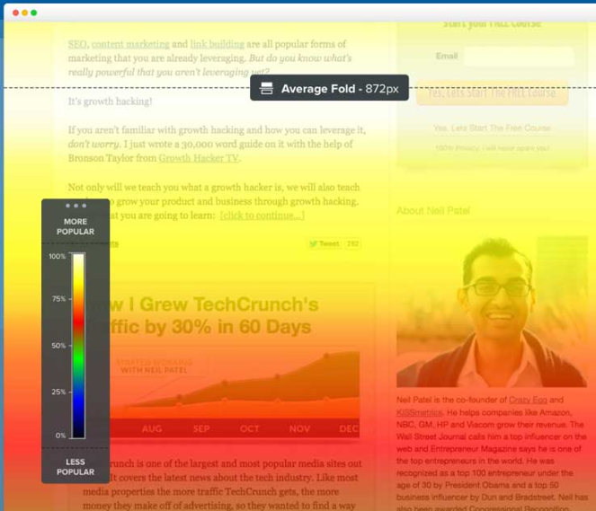
B. Scrollmaps
Scrollmaps visually represents the scrolling behavior of your visitors with the help of colors, and also reflect the percentage distribution of visitors across the page based on how much they scroll. It helps you figure out how far visitors scroll down on your page, sections in which they spend the most time, sections of a page beyond which visitors do not scroll, and more.

Slide 9
C. Clickmaps
Like heatmaps, clickmaps also give you real-time data on how visitors interact with your web pages. They track the visitors’ clicks and help you identify which section of a page visitors click most and least on, which images they click on, links that are clicked often and those that aren’t navigational gaps, and so on.

Slide 10
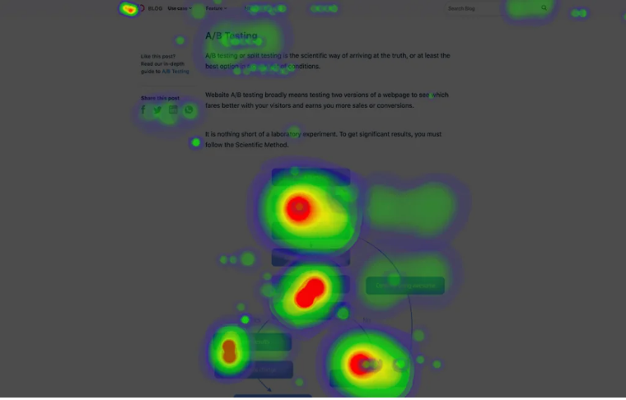
D. Mouse tracking heatmap
Mouse tracking heatmaps track how visitors’ cursors hover on a page. Based on their cursor’s movement, mouse tracking heatmaps help you discover where visitors spend the most and least time in, sections through which they just scroll over without paying much attention, and so on.

Slide 11
E. Eye-tracking heatmap
Eye-tracking heatmaps give you data on your visitors’ gaze behavior. They help you identify images on which visitors’ gaze is fixed for a substantial amount of time, elements that divert their attention from important content, and so on.
All this is tracked based on 2 parameters namely fixation length and frequency, and then graphically presented in the form of hot and cold spots based on your visitors’ eyeball movement.

Slide 12
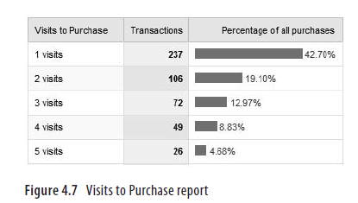
Visits to purchase
Avg Visits to Purchase: Average number of sessions from first website interaction to Purchase.
Avg Days to Purchase: Average number of days from first website interaction to Purchase.

Slide 13
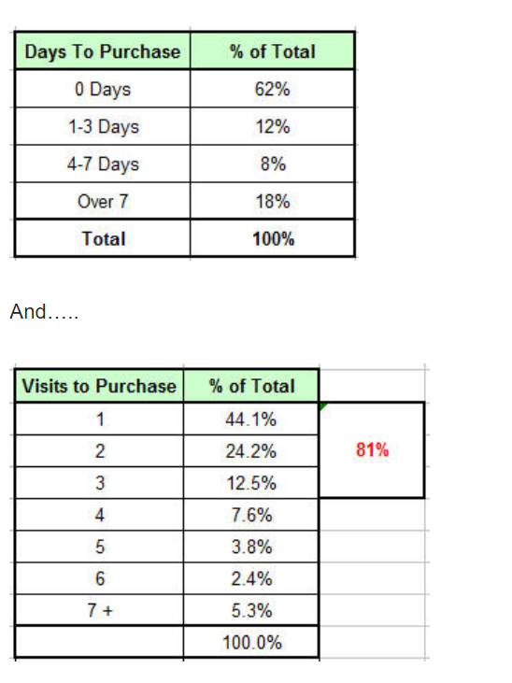

Slide 14
Sources of traffic
In web analytics, traffic sources are dimensions that are visualized in a report that provides an overview of the sources of traffic to a website.
An example of a traffic source is direct traffic (users typing the URL into the browser or clicking from bookmarks) or traffic from search engines.

Slide 15
The types of sources that are commonly used in web analytics are:
Direct traffic: All those people who find a website by typing the URL or through a bookmark.
Referral Traffic: Other websites that send traffic to a site. These can be as a result of banners, campaigns, blogs, or affiliates linking to the site owner, or news aggregators like menéame.
Organic traffic: coming from search engines such as Google, Yahoo,Bing, Ask or others.
Paid traffic: coming from PPC and display media, such as Google Adwords, Bing Ads, Facebook Ads, Twitter Ads…
Social Media traffic from social networks such as Facebook, Twitter, Instagram…
Other: These include campaigns, email, direct marketing, et

Slide 16
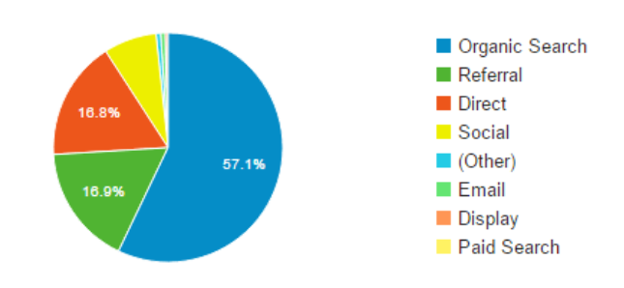
What are traffic sources in Google Analytics?
https://www.webfx.com/digital-marketing/learn/what-are-the-best-traffic-sources/

Slide 17
Direct Traffic Analysis
Direct Traffic is typically defined as noncampaign, nonsearch, nonlinked traffic, that is, Visitors who come to your website by typing in your website’s URL or who come through a bookmark.
Capturing Direct Traffic
To accurately capture Direct Traffic, you need to do the following:
Tag all your website pages so you won’t lose the referring/• campaign information the Visitors might bring with them.
Make sure your different campaigns contain the proper tracking parameters.

Slide 18
Segmenting to Understand Uniqueness
Content analysis :what pages/content directories these people visit most often
Purchase behavior Visitors who come through Direct Traffic are often, but not always, existing customers, and understanding what they buy is an insightful exercise

Slide 19
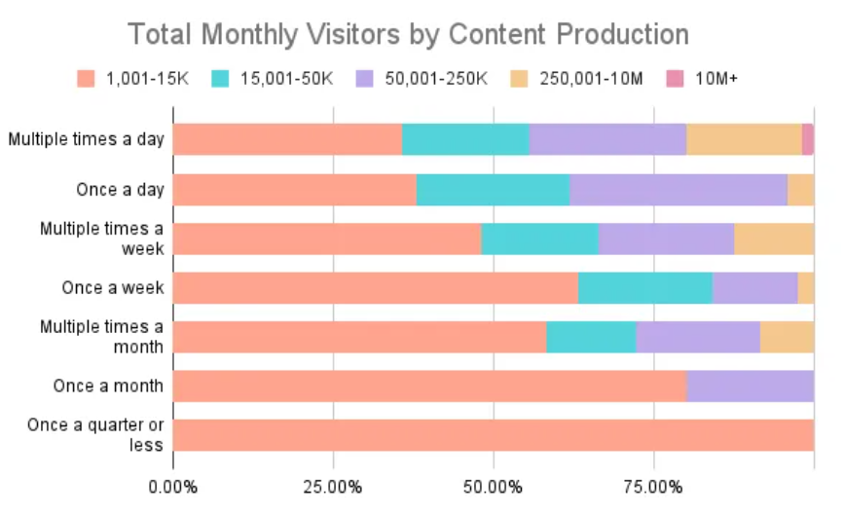
Visitor Analysis

Slide 20
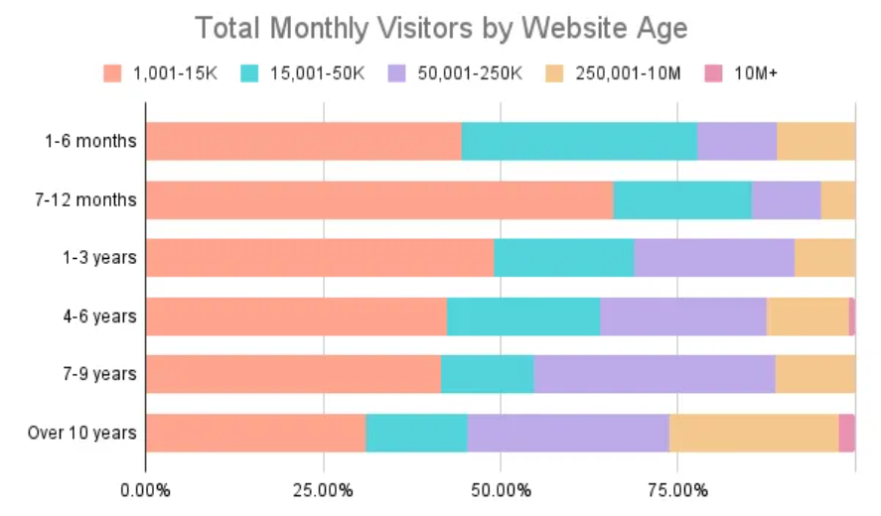

Slide 21
Traffic Analysis
Web traffic analytics tells you who visits your website and what they do. It gives insight into what content your users love and give you insights to help improve conversions.
How much traffic your site gets in a given time period.
Which content is most popular.
Your bounce rate.
How many new visitors you get.
Where your traffic comes from.
How long people stay on specific pages.
How often users return to your website.

Slide 22
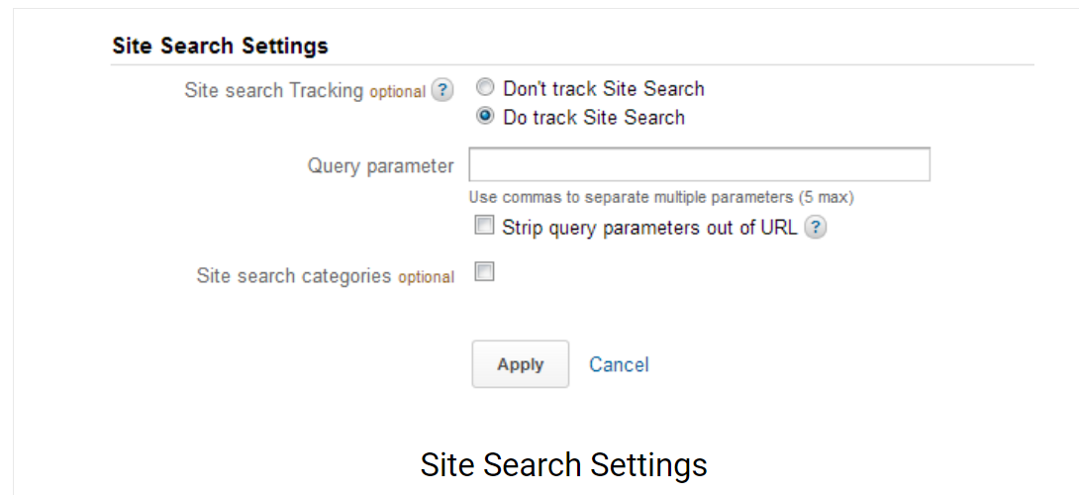
Internal Site Search Analysis
Internal site search is the search which the visitors perform within a website. Tracking site search result data is extremely valuable for an online business as it helps to know what the visitors are looking for on the website.

Slide 23
To enable site search tracking on your website, follow the steps given below:-
1- Visit Google Analytics settings page and click on the site for which you want to change the settings.
2- Click on admin located on top right hand side corner of the screen and then click on site name. Now, click on profile settings.
3- In the Edit Profile Information section, check the radio button ” Do Track Site Search”.

Slide 24
- Enter the query parameter (In normal cases, query parameter is “q” else look for the query parameter in your site’s search url.) You may provide upto 5 parameters separated by a comma.
5- If you want to include categories for search then check on “Yes” under “Do you use categories for site search”.
6- Enter the category parameter.(Identify the category parameter the same way as the query parameter) and click apply.

Slide 25
Pay Per Click/Paid Search Analysis
If you search the word Omniture on www.google. com
you get two listings—one organic and one paid. The organic listing goes to the URL www.omniture.com.
The paid listing goes to the URL
www.omniture.com/static/1923?s_scid=TC|5379|omniture||S|e|2831181395.
Everything you see after the question mark (?) in the previous URL is known as the referral string, and it contains a tracking parameter that tells Omniture which click came organically and which came via PPC. Without the tracking parameters, bothclicks would be considered as coming from organic search.

Slide 26
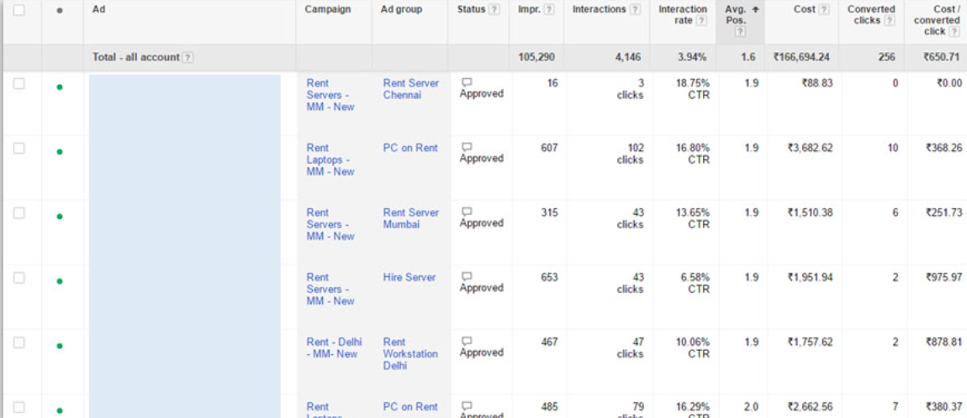
Analyzing PPC Ad Position
Measuring PPC Customer Behavior

Slide 27
Email Campaign Analysis
Analyzing email campaigns requires three important insights:
• You must use metrics that are unique to the medium.
• You can’t track everything.
• You need to think end-to-end and not just in a silo.
Here are the metrics, beyond the standard emails sent, that will help you analyze performance:
Delivery rate = (# of emails sent – # of bounce backs) / # of emails sent
Open rate = # of emails opened / # of emails sent
Click-to-open rate (CTOR) = # of clicks / # of emails opened
Subscriber retention rate = # subscribers – bounce backs – unsubscribes / # subscribers

Slide 28
Here are two useful metrics to inspire the kinds of analysis you should do for website behavior:
Bounce Rate = # of email campaign visits with a single Page View / # of email campaign visits
Length of Visit = percent of email campaign visits that last longer than xx seconds
Conversion Rate = # of Orders / # of email campaign Visits
Average Revenue per Email Sent = total revenue / # of emails sent
Email Campaign Profitability = (Revenue generated – campaign cost – cost of goods sold) / # of emails sent

Slide 29
Rich Experience Analysis: Flash, Video, and Widgets
Analyzing and understanding rich-media website experiences built with Ajax, Flash, Flex, or
embedded pieces of rich content such as videos, widgets, and so on.

Slide 30
END

Slide 31
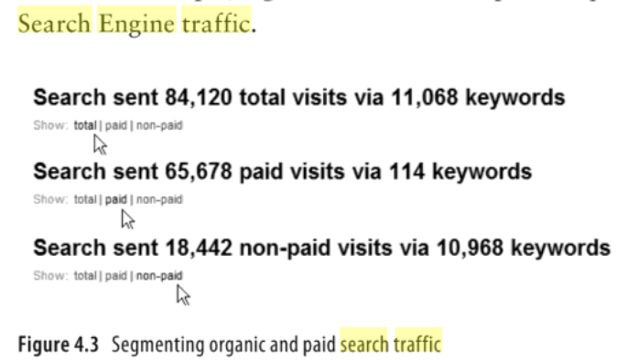

Slide 32
visitor tracking
Visitor tracking refers to the process of tracking the activities and characteristics of a website visitor. This gives site owners in-depth insights into the needs and requirements of the visitors by analyzing their on-site activities and behavior.
Visitor tracking also provides information around how a visitor landed on your website, what’s their geographic and demographic profile, their age, the device they’re using, and so on.

Slide 33
4 best analytical tools to evaluate visitor behavior
There are 4 tools through which you can conduct visitor behavior analysis namely,
website heatmap
session recording,
website surveys
and form analytics
https://vwo.com/visitor-behavior-analysis/

Slide 34
2. Session recording
Session recording enables you to record user and visitor sessions on your website which is later analyzed to dig insights into how visitors interact with your website. It enables marketers to step into their audiences’ shoes and experience first-hand what they experienced on your website. Session recording not only enables you to understand visitor behavior but also identifies leakages in the funnel and friction areas on your website.

Slide 35
https://saylordotorg.github.io/text_emarketing-the-essential-guide-to-online-marketing/index.html

